Slide 1
Assignment Two
Graph Visualization
Amazon Beauty Product Reviews
February 4, 2026
Dr. Joseph Foy, CPA
Online Business Programs
CUNY School of Professional Studies
A Python-Gephi Analysis

Slide 2
Overview
Assignment Overview
From the Stanford Large Network Dataset Collection, I analyzed a network constructed from Amazon Beauty product reviews, which was stored in a CSV file within a zip file.
Citation for specific dataset:
Ni, J., Li, J. and McAuley, J. (2019). Justifying Recommendations using Distantly-labeled Reviews and Fined-grained Aspects. Empirical Methods in Natural Language Processing.
The nodes represent Reviewers and Products. The edges represent a review linking a Reviewer to a Product. This structure allows one to study patterns of consumer behavior and product popularity using graph analytics and visualization.
The type of graph is bipartite. Reviewers connect only to Products, and vice versa. Reviewers do not connect to Reviewers, and Products do not connect to Products.

Slide 3
Python Code for Gelphi
# Import Required Packages
import networkx as nx # I used NetworkX to construct and analyze the network graph, including centrality and diameter.
import gzip # I had to use gzip because the dataset was compressed as a .gz file.
import json # I used json to convert each review from raw text into a readable Python dictionary.
import pandas as pd # I used pandas to organize the review data into a structured table.
# Load the Amazon Beauty Review Dataset
# Each line in the file represents one review in JSON format.
# Since the dataset was compressed, I had to read it line-by-line using gzip
# and convert each review into a Python object.
with gzip.open("all-beauty-5.json.gz", "rt", encoding="utf-8") as f:
data = [json.loads(line) for line in f]
# After loading the raw review data, I converted it into a pandas DataFrame
# so that I could easily construct the network from structured columns.
df = pd.DataFrame(data)

Slide 4
Python Code for Gelphi
# I created a bipartite network where:# Reviewers represent one type of node.
# Products (ASINs) represent another type of node.
# Each review forms a connection between a reviewer and a product.
G = nx.from_pandas_edgelist(df, source="reviewerID", target="asin")
# I printed the total number of nodes and edges to understand
# the overall size and density of the network.
print("Total Nodes:", G.number_of_nodes())print("Total Edges:", G.number_of_edges())
Total Nodes: 1076
Total Edges: 4092

Slide 5
Python Code for Gelphi
# Isolate the Largest Connected Component
# Because real-world networks often contain disconnected pieces,
# I extracted the largest connected component to focus my analysis
# on the main structural core of the network.
largest_cc = max(nx.connected_components(G), key=len)
G_cc = G.subgraph(largest_cc)
# I calculated the graph diameter to measure the maximum distance
# between any two nodes in this main component.
print("Graph Diameter (Largest Component):", nx.diameter(G_cc))
Graph Diameter (Largest Component): 10

Slide 6
Python Code for Gelphi
# Degree Centrality measures how many direct connections each node has.
# It reflects how many reviewers reviewed products and how many products they reviewed.
degree_centrality = nx.degree_centrality(G_cc)
# I displayed the six most central nodes to identify which actors are most structurally influential in the network.
print("\nTop 6 Nodes by Degree Centrality:")
for node, score in sorted(
degree_centrality.items(),
key=lambda x: x[1],
reverse=True)[:6]:
print(node, round(score, 4))
Top 6 Nodes by Degree Centrality:
B0012Y0ZG2 0.8174
B000URXP6E 0.7959
B00006L9LC 0.4579
B001OHV1H4 0.4579
B0009RF9DW 0.3614
B000FI4S1E 0.3614

Slide 7
Python Code for Gelphi
# Prepare Data for Visualization (Gephi Export)
# Create node classification table (Reviewer vs Product)
# To prepare the data for Gephi visualization,
# I created a node table to distinguish between reviewers and products.
nodes_df = pd.DataFrame({"Id": list(G_cc.nodes())})
# Since Amazon product IDs typically begin with "B",
# I used that pattern to classify product nodes.
nodes_df["Type"] = nodes_df["Id"].apply(
lambda x: "Product" if x.startswith("B") else "Reviewer")
# I exported this node table so I could color-code nodes in Gephi.
nodes_df.to_csv("beauty-nodes.csv", index=False)

Slide 8
Python Code for Gelphi
# I also exported the edge list so that each reviewer–product
# relationship could be visualized in Gephi.
edges_df = pd.DataFrame(G_cc.edges(), columns=["Source", "Target"])
edges_df.to_csv("beauty-network.csv", index=False)

Slide 9
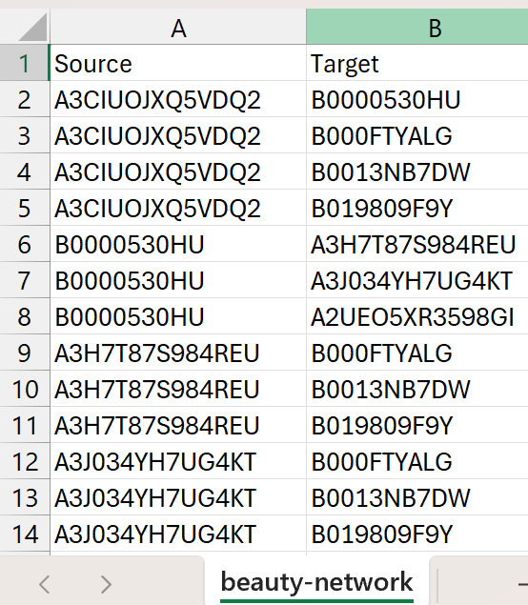
Dataset Construction
This spreadsheet content represents the edge list used to construct the network.
Each row corresponds to a single review and contains a source node (reviewer) and a target node (product).
This structure allows the same relationships to be analyzed programmatically in Python and visually in Gephi. I used Gephi as the primary visualization and exploratory analysis tool.

Slide 10
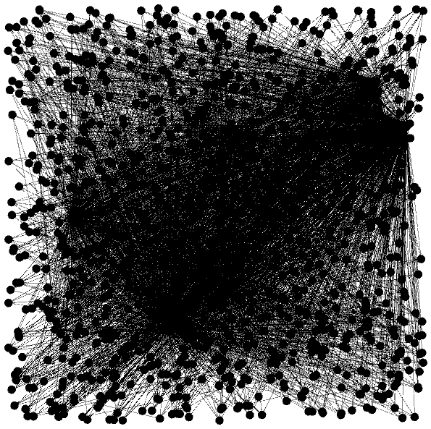
Raw Data
Import to Gephi: This initial visualization shows the raw network immediately after import, before any filtering, layout tuning, or visual adjustments.
At this stage, all nodes and edges are drawn with default settings.
There are 1,076 nodes, 4,092 edges.
Main issue: the structure is difficult to interpret due to heavy overlap and extreme edge density.
Basically, it is unreadable.

Slide 11
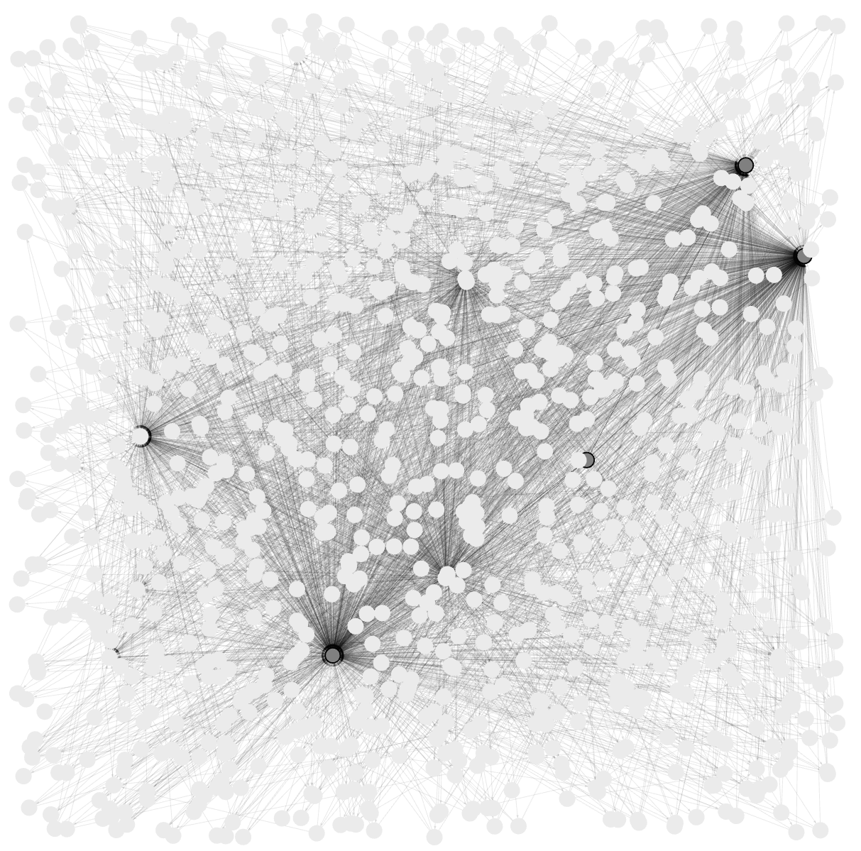
Raw Data – Transparency Applied
To improve interpretability, I hoovered over some nodes and the edges became more transparent.
The dense areas of the graph emerged showing overlapping edges.
This step shows hints of clusters without removing any data.

Slide 12
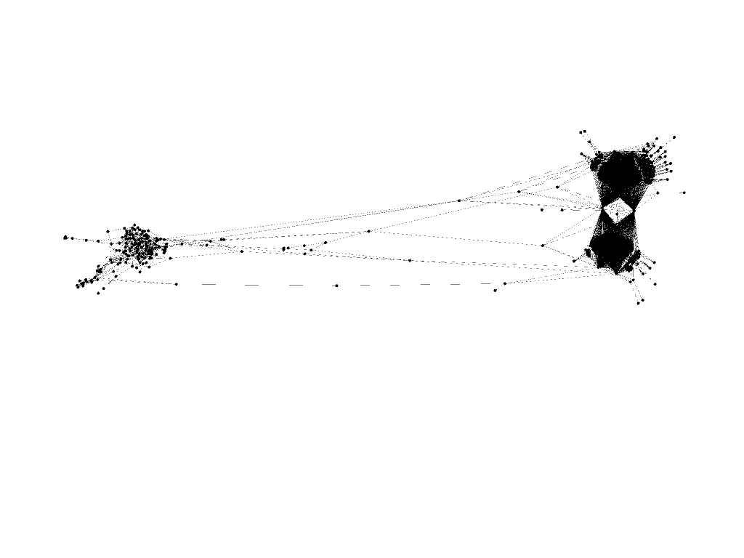
ForceAtlas2 Applied
I applied the ForceAtlas2 layout.
This layout pulls strongly connected nodes closer together while pushing weakly connected or peripheral nodes outward.
We now see clear structural separation between dense core components and loosely connected peripheral groups.

Slide 13
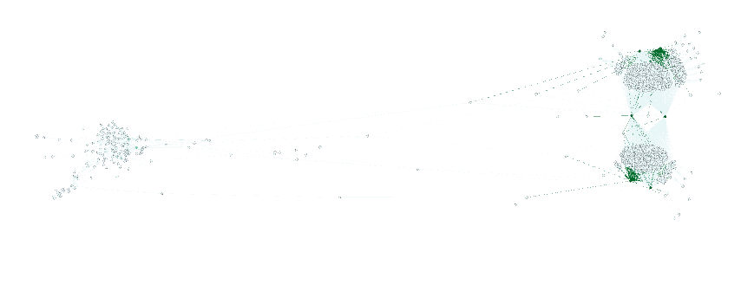
ForceAtlas2 Coloration Applied
I applied node coloration and size scaling based on degree.
Nodes with a higher degree are those connected to many others. They appear larger and darker. They highlight highly reviewed products.
Nodes with a smaller degree are not well connected. They appear lighter.
Benefit: Makes hubs immediately visible without reading numbers.

Slide 14
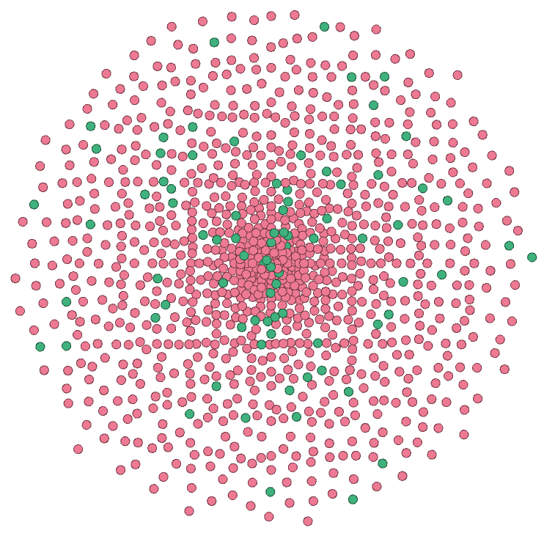
Color Filtering Reviewers and Reviews
Raw graph of all the Reviewers and Products.
Red = Reviewers
Green = Products
Using filters, I isolated reviewer-only and product-only views of the network.
This makes it easier to focus on specific analytical questions by identifying highly reviewed products and understanding reviewer patterns.
Filtering does not remove data permanently. It allows targeted exploration of complex networks.

Slide 15
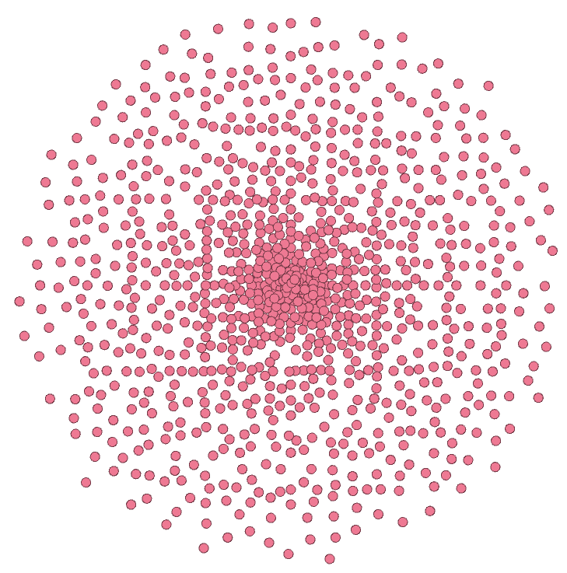
Reviewer-Only Coloration Applied
Raw graph of all the Reviewers.
Red = Reviewers
Using filters, I isolated Reviewer-only views of the network.
This makes it easier to see how many Reviewers are in the data.

Slide 16
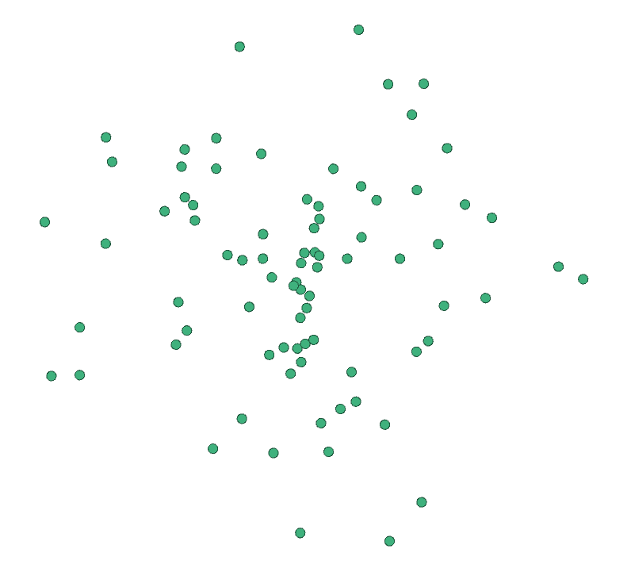
Product Reviews
Raw graph of all the Products.
Green = Reviewers
Using filters, I isolated Product-only views of the network.
This makes it easier to see how many Products are in the data.

Slide 17
Metrics
Diameter
The diameter of the largest connected component is 10, meaning the longest of the summation of the shortest paths between any two nodes in the network is ten steps.
Centrality
Degree centrality highlights the most influential nodes. Primarily products with many reviews.
The product ending in “G2” has a centrality score of 0.8174, meaning that it is directly connected to nearly 82% of the maximum possible reviewer connections within the network. This suggests that the product is widely reviewed in the network.
Diameter Output
Graph Diameter = 10
Centrality Output
Top 6 nodes by degree centrality:
B0012Y0ZG2 | 0.8174
B000URXP6E | 0.7959
B00006L9LC | 0.4579
B001OHV1H4 | 0.4579
B0009RF9DW | 0.3614
B000FI4S1E | 0.3614

